Slide 1
Sparsity in Deep Neural Networks and The Lottery Ticket Hypothesis
Tejas Pote

Slide 2
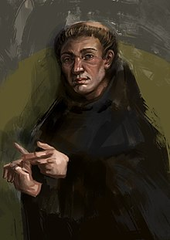
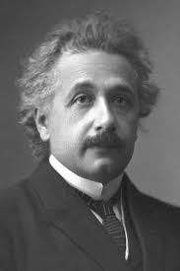
“All things being equal, the simplest solution tends to be the best one!!!!”
--- William of Ockham
“Everything should be made as simple as possible, but not any simpler!!!!”
--- Albert Einstein
Notes:
Ideas revolving around minimalistic explanations

Slide 3
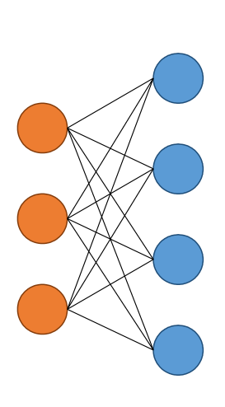
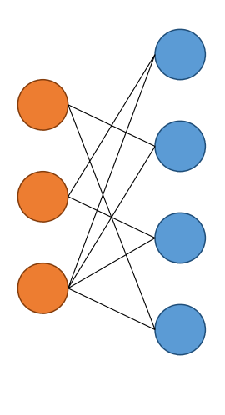
Sparsity in Neural Networks
Sparsification
Technique
Sparse Network
Dense Network

Slide 4
Preliminaries
Prune :
Removing superfluous/ unwanted parts of something
Notes:
Glossary

Slide 5
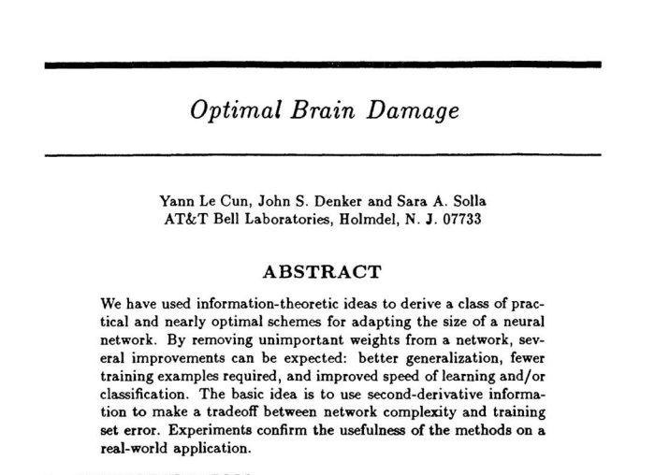
Preliminaries

Slide 6
Why prune neural networks?
Parameter Redundancy in dense training.
Vision Transformers
22 Billion Parameters
GPT-4
1.7 Trillion
Parameters
AlphaFold
21 million parameters

Slide 7
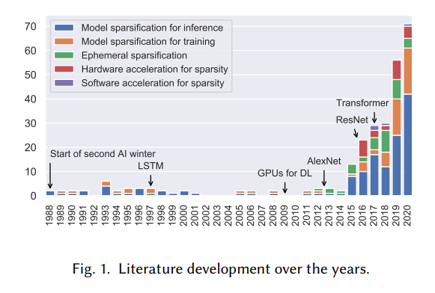
Why prune neural networks?
Saturation of architectural specializations.
Source

Slide 8
Background: What can be pruned?
Structured Pruning: Dropping off redundant neurons/filters in the network.
Pros:
The computational speedup due to sparsity can be realized on conventional hardware
Easier interpretability
Cons:
Poor generalization performance at extremely large sparsities.
Loss of granularity in pruning.

Slide 9
Background: What can be pruned?
Unstructured Pruning: Dropping off redundant parameters in the network.
Pros:
Generalize well at extremely high sparsities
Fine-grained pruning across the network
Cons:
Cannot be realized on conventional hardware
Storage overhead due to indices of sparse entries

Slide 10
Background: Iterative Magnitude Pruning
Train a dense network
Remove superfluous structure
Fine-tune the network
Repeat 2 and 3 iteratively

Slide 11
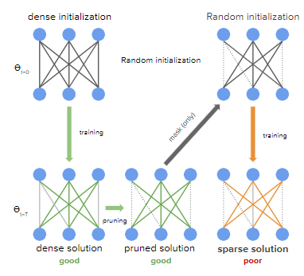
Background: Iterative Magnitude Pruning

Slide 12
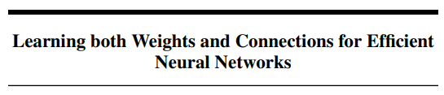
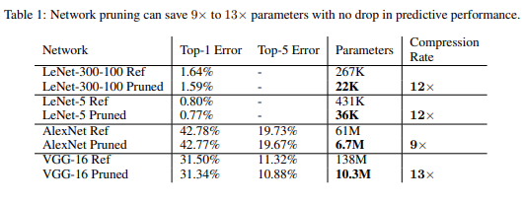
Background: Iterative Magnitude Pruning
Train a dense network
Remove superfluous structure
Fine-tune the network
Repeat 2 and 3 iteratively

Slide 13
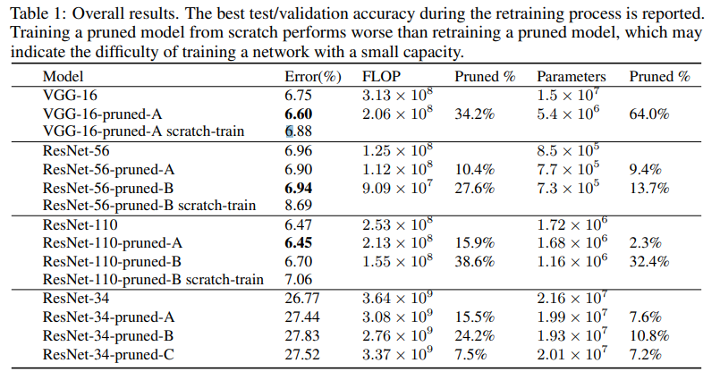
Training the pruned network from scratch?
Pruning the pruned network from scratch leads to worse performance than dense training!

Slide 14
Lottery Ticket Hypothesis
---Jonathan Frankle, Michael Carbin---
Best Paper Award, ICLR 2019
(paper)

Slide 15
Lottery Ticket Hypothesis
Motivation:
Can sparse neural networks be trained from scratch?

Slide 16
Lottery Ticket Hypothesis
Motivation:
Can sparse neural networks be trained from scratch?
Corollary : Do neural networks have to be heavily overparameterized?

Slide 17
Lottery Ticket Hypothesis

Slide 18
Lottery Ticket Hypothesis

Slide 19

Lottery Ticket Hypothesis

Slide 20
Lottery Ticket Hypothesis

Slide 21
Lottery Ticket Hypothesis
Winning Ticket

Slide 22
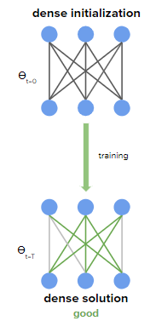
Procedure for finding winning tickets..
Randomly initialize the full network and train.

Slide 23
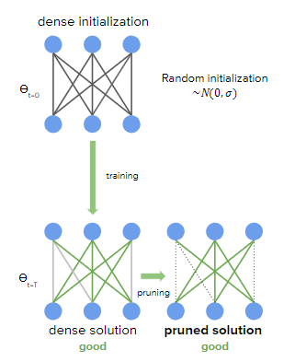
Procedure for finding winning tickets..
Randomly initialize the full network and train.
Prune the weights by magnitude

Slide 24
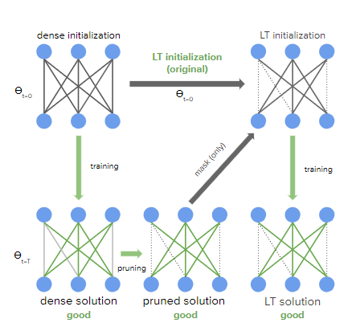
Procedure for finding winning tickets..
Randomly initialize the full network and train.
Prune the weights by magnitude
Reset each remaining weight to its original initialization
Repeat 2 and 3 iteratively

Slide 25
Results
Sparse, trainable subnetworks for:
Fully connected networks trained on MNIST
Convolutional networks trained on CIFAR10
Networks employing dropout, weight decay, batch-norm, etc

Slide 26
Results
Sparse, trainable subnetworks for:
Fully connected networks trained on MNIST
Convolutional networks trained on CIFAR10
Networks employing dropout, weight decay, batch-norm, etc
The pruned networks should be trained with the same initializations…

Slide 27
Results
The subnetworks:
Have sizes ranging between 15% to 1% of the original network
Learn faster than the original network
Achieve commensurate generalization performance

Slide 28
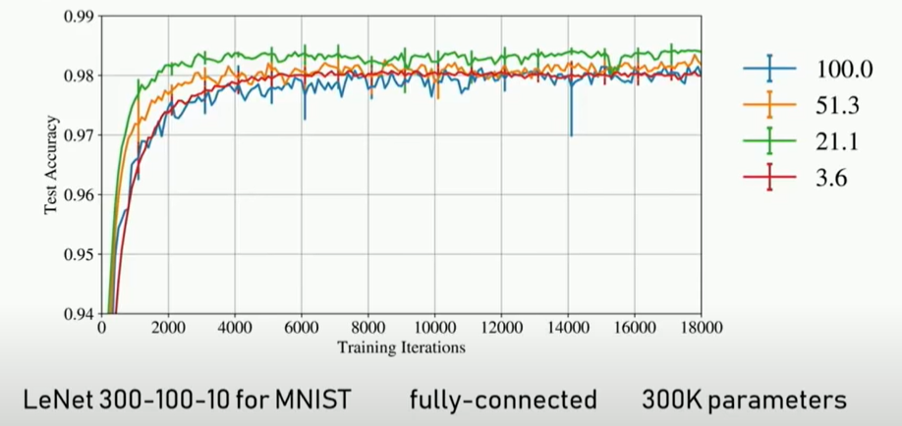
Results

Slide 29
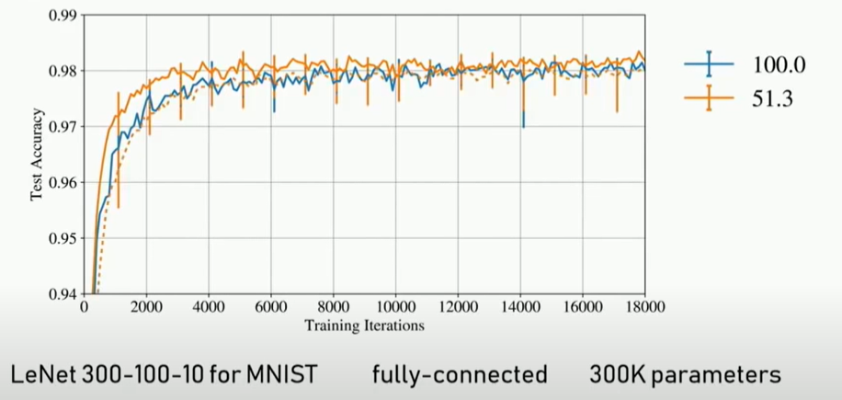
Results

Slide 30
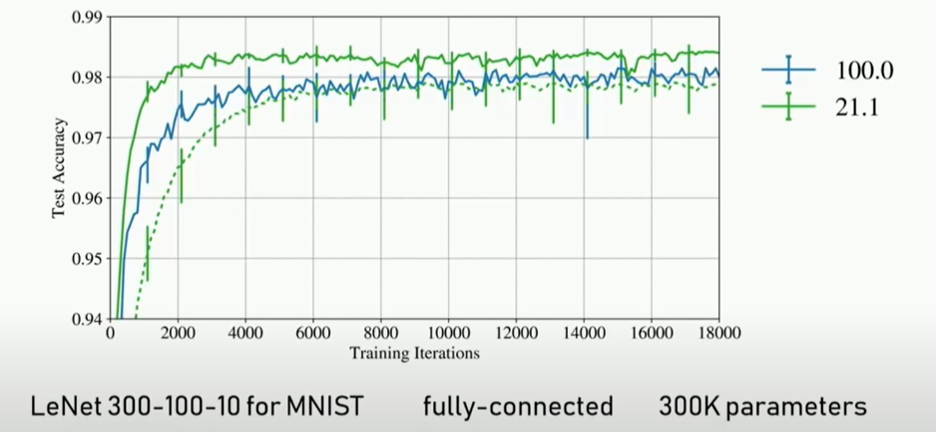
Results

Slide 31
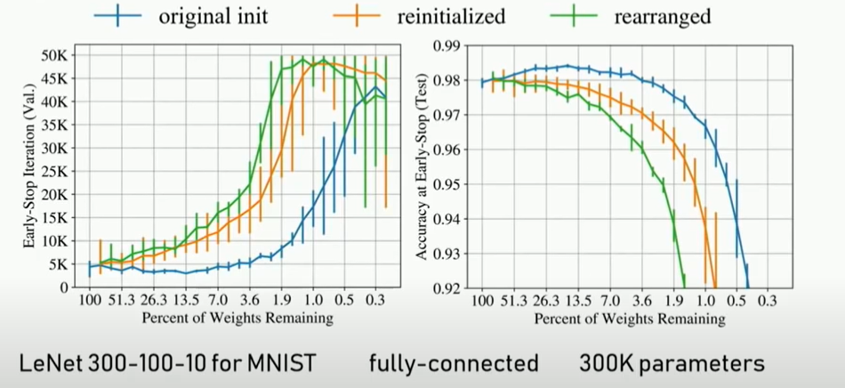
Results

Slide 32
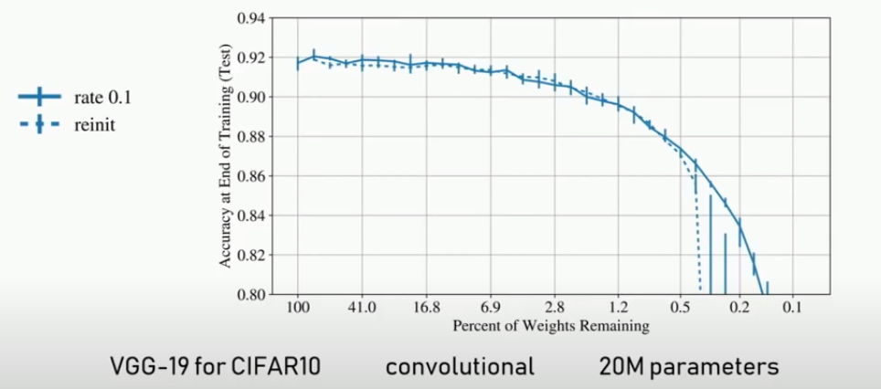
Results

Slide 33
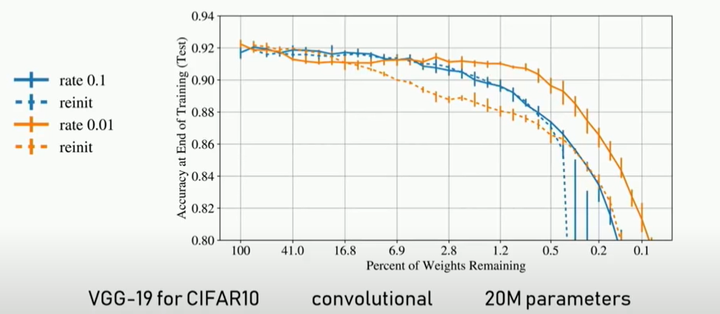
Results

Slide 34
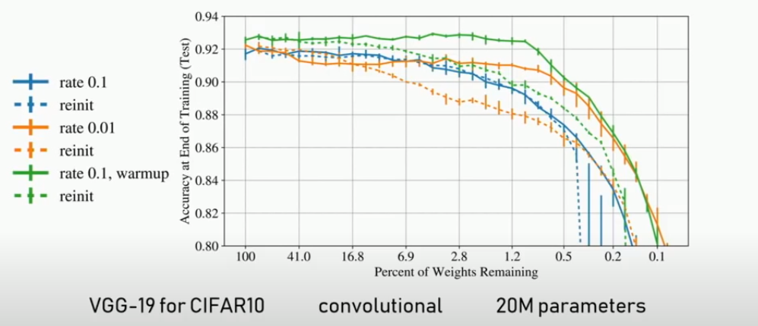
Results

Slide 35
Limitations of Lottery Ticket Hypothesis
The method of finding lottery tickets is expensive.
The hypothesis isn’t justified for large networks (VGG19 and ResNet-18)
Lack of a principled basis for efficacy of warmup.

Slide 36
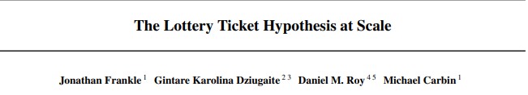
Workaround!
‘Sparse, trainable subsets (lottery tickets) of deep neural networks emerge early in training (rather than at initialization)’
(paper)

Slide 37
Workaround!

Slide 38
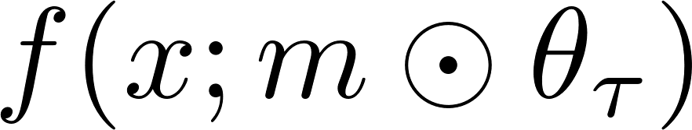
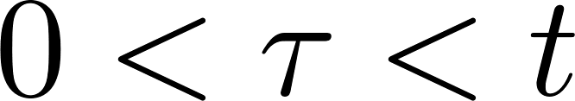
Workaround!

Slide 39
Workaround!
Weight resetting/rewinding

Slide 40
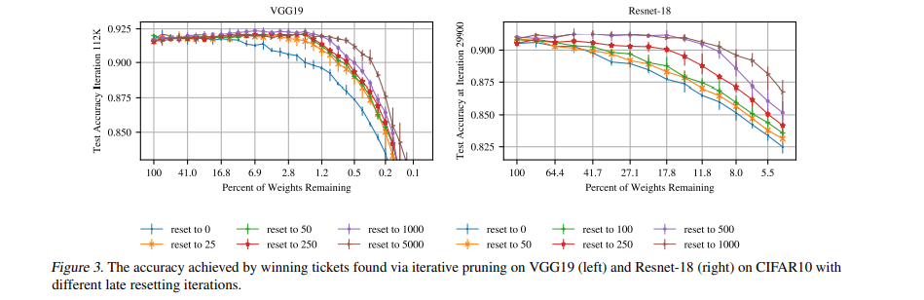
Results

Slide 41
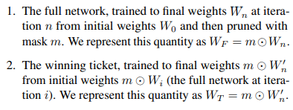
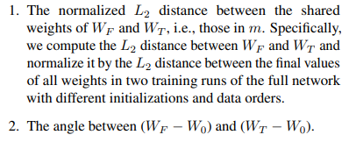
Stability Analysis
The stability of training to pruning (with respect to a specific pruning mask) as the extent to which the optimization trajectories of the unmasked weights produced by training without the mask (i.e., the entire network) and with the mask (i.e., the pruned network) are similar.
When training is stable to pruning, the final values of the unpruned weights in both cases are close.

Slide 42
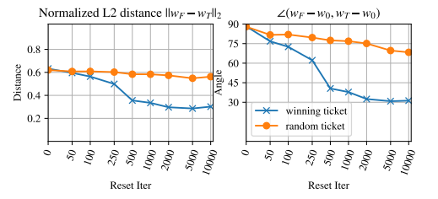
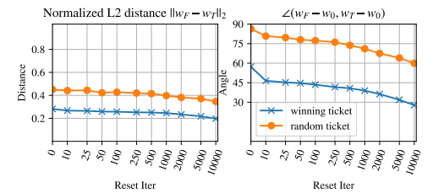
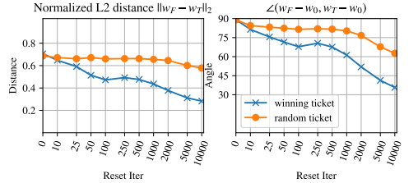
Stability Analysis
Stability metrics at the end of training for Resnet-18 (left), Lenet (middle), and VGG19 (right). WF and WT are unpruned weights when they are trained as part of the full network and in isolation, respectively. Random tickets are formed by randomly permuting the per-layer pruning masks of the winning ticket.

Slide 43
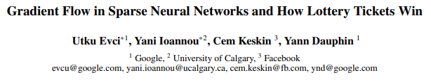
What makes the lottery tickets so special?
(paper)
Maybe there is something fundamentally different in training from Lottery Ticket initialization than random initialization?
Are we re-learning the pruned solution?

Slide 44
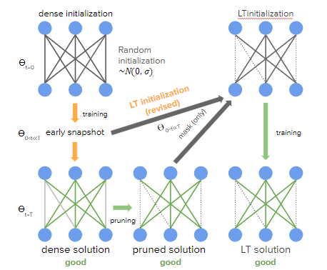
What makes the lottery tickets so special?

Slide 45
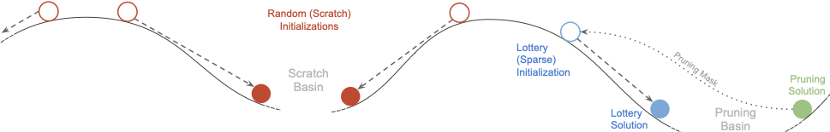
What makes the lottery tickets so special?
Intuitionally suggest the above relationship between the LT/pruning solution and scratch solutions on the sparse loss-landscape

Slide 46
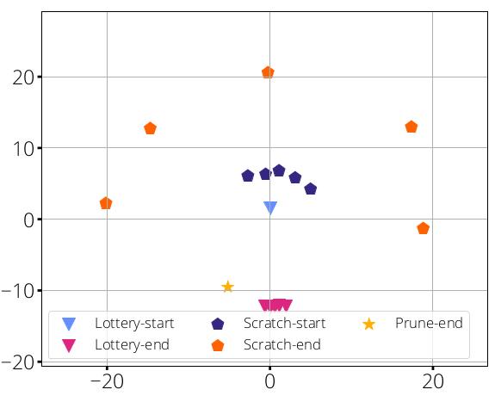
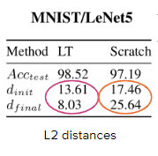
Proximity to pruned solution
L2 distance and MDS:
Multidimensional Scaling (MDS): distance-preserving transformation
Mean over 5 LT/scratch, same pruning soln.
Original LT Initialization
LT: end up closer to the pruned solution than random initialization
Scratch (same mask, random initialization) end up far from initial/pruned solution.

Slide 47
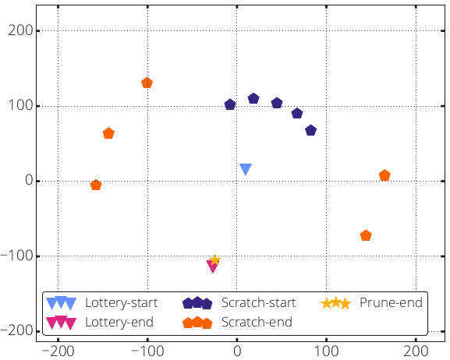
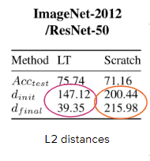
Proximity to pruned solution
L2 distance and MDS:
Multidimensional Scaling (MDS): distance-preserving transformation
Mean over 5 LT/scratch, same pruning soln.
Original LT Initialization
LT: end up closer to the pruned solution than random initialization
Scratch (same mask, random initialization) end up far from initial/pruned solution.

Slide 48
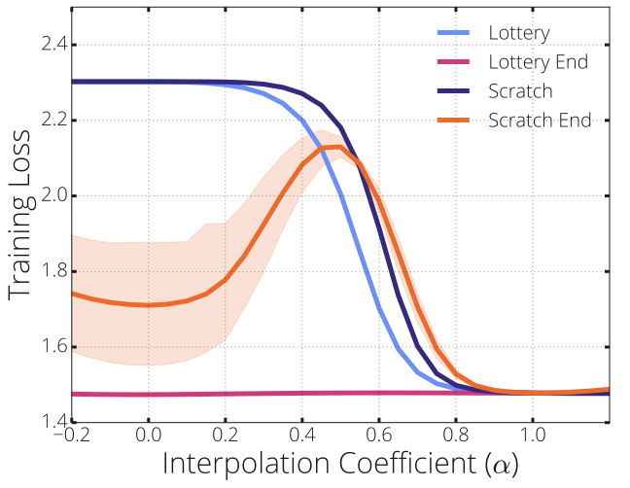
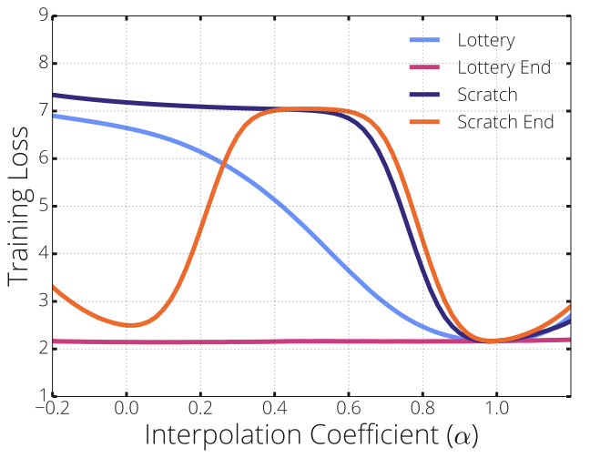
Basin of Convergence
Look at linear path between the pruned solution on the loss landscape (𝛼=1) and LT/scratch (𝛼=0)
At initialization ("Start" of training), and
At solution ("End" of training).
Scratch soln. ↔ pruned solution: high loss barrier
LT soln. ↔ pruned soln.: relatively flat
MNIST/LeNet5
ImageNet/ResNet-50

Slide 49
Summary and Directions of Research
Lottery Ticket Hypothesis empirically shows the existence of smaller subnetworks within dense nRetworks and outlines a training procedure for finding them.
However, the necessity of dense training still accounts for most of the compute and doesn’t solve our purpose.
At this date, there exist a number of dynamic sparse training methods which eliminate the need for dense training and introduce completely sparse training schedules^{1,2}.
Scalable Training of Artificial Neural Networks with Adaptive Sparse Connectivity inspired by Network Science
Rigging the Lottery: Making All Tickets Winners

Slide 50
THANK YOU

